Slide 1


Arnold BARNA
Electrical engineer since 2000 (energy sector, University of Óbuda)
English (C1)
German (B2)
Seasoned project manager
08.12.2017

Slide 2
Integration Tests
Controllers
End points
Services
Validation, Business Logic
Repositories
Database connections
Context
SQL Tables

Slide 3
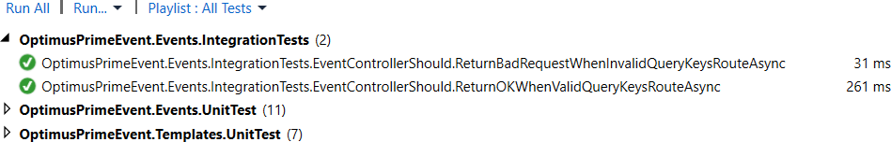
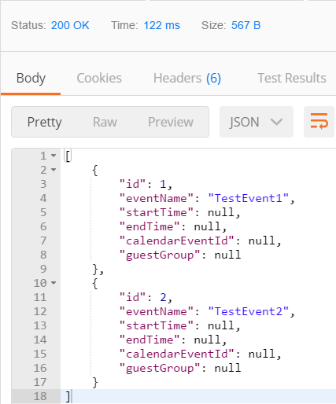
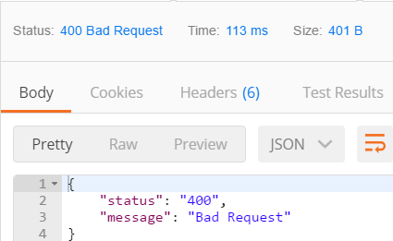
Integration Test for Http OK (#200)

Slide 4
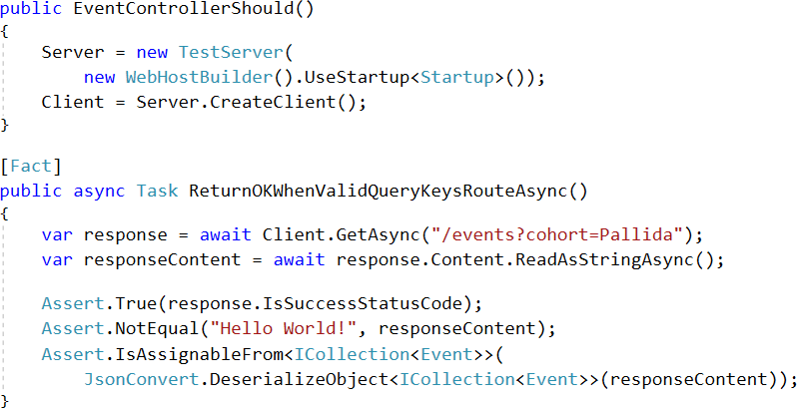
Integration Test for Http OK (#200)
Arrange
Act
Assert

Slide 5
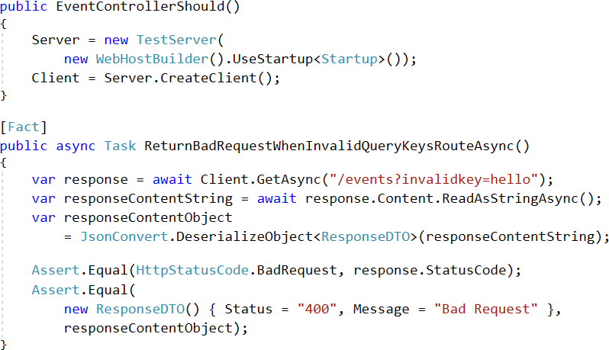
Integration Test for Http Bad Request (#400)
Arrange
Act
Assert

